Slide 1
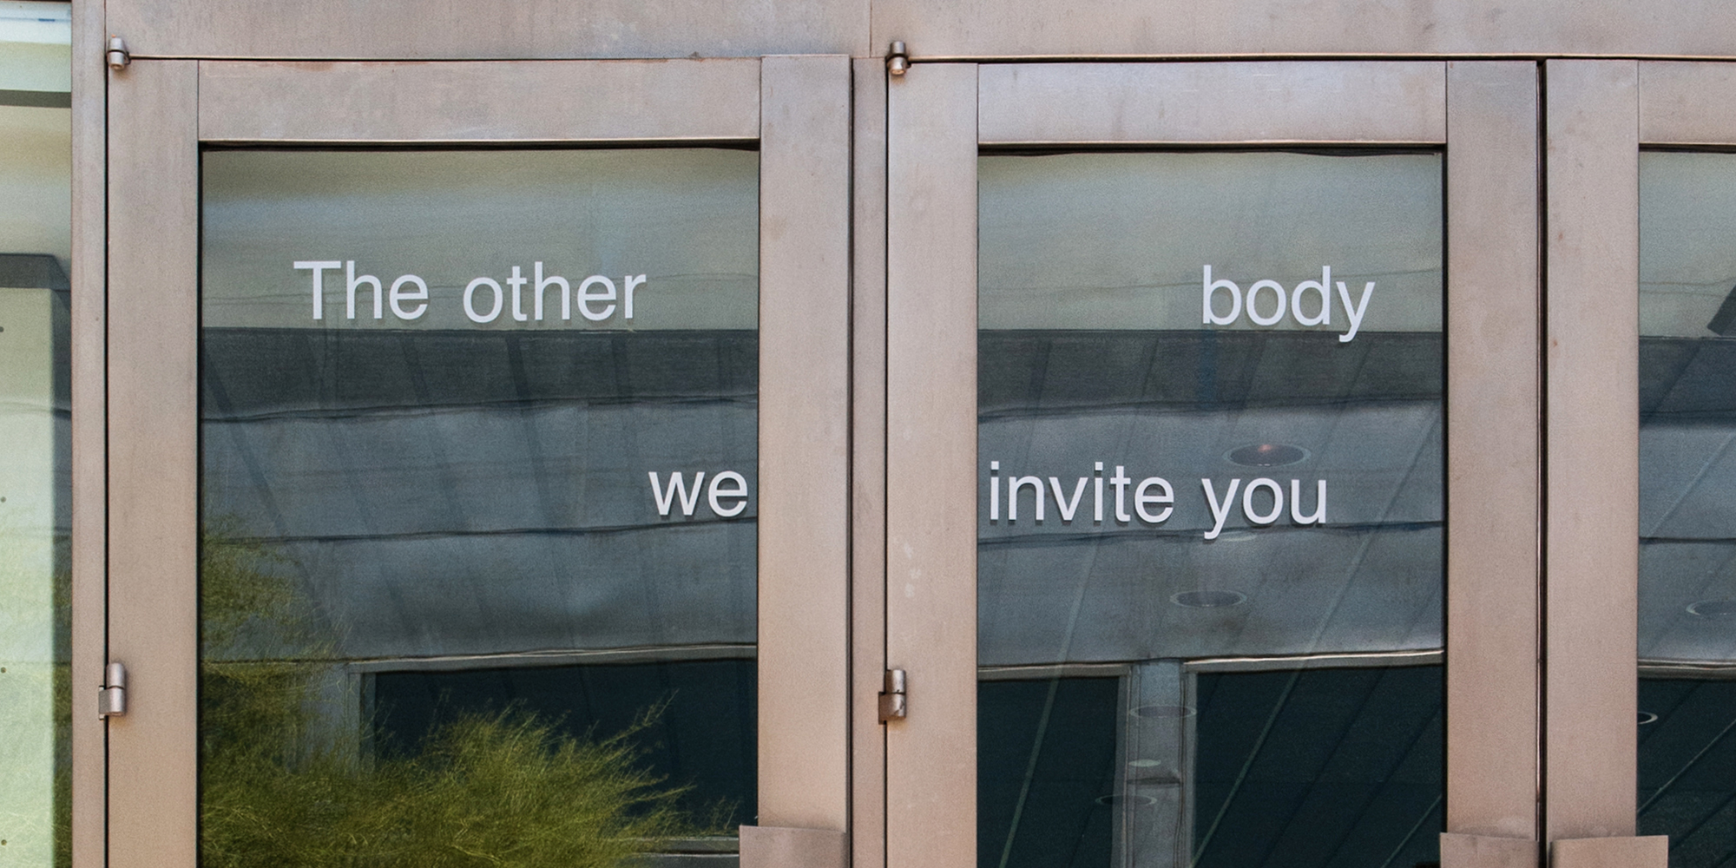
Beware! Artwork (and modest proposal for it) Ahead!
Gregory Sale, 2012, Phoenix Art Museum

Slide 2
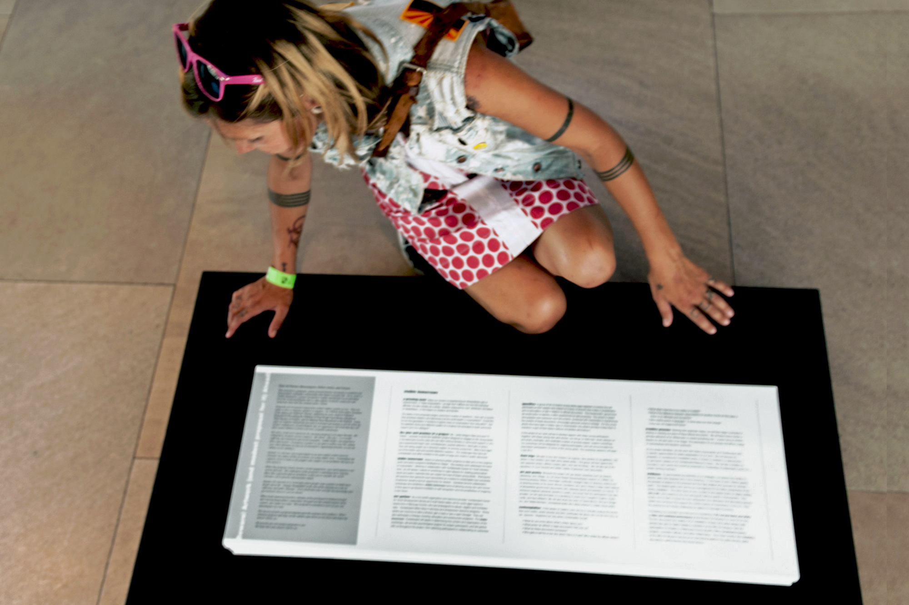

Slide 3
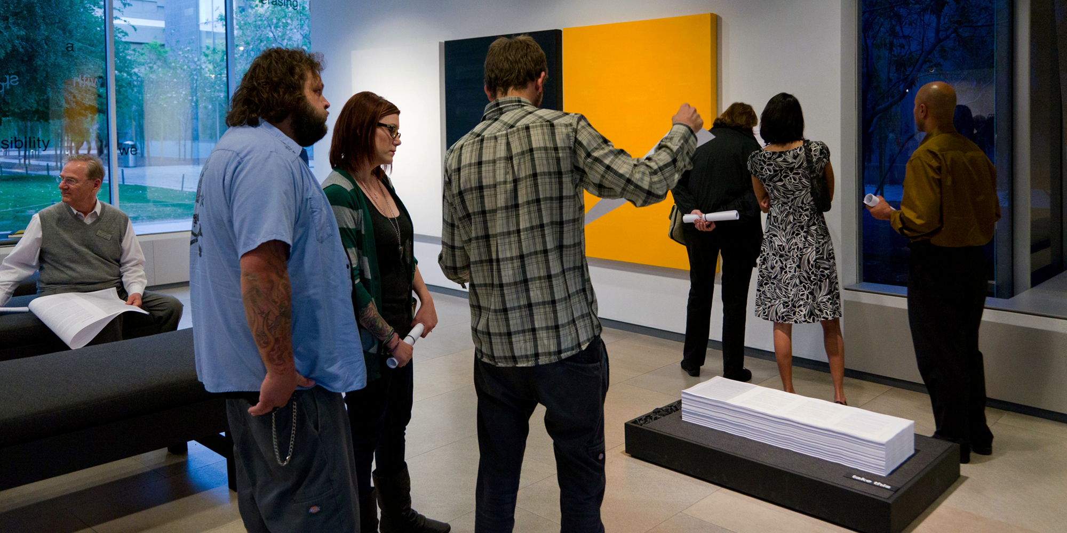
At the center of Beware! Artwork (and modest proposal for it) Ahead! is a proposal for visible tomorrows, a project designed to engage and disrupt on an individual level the social mechanisms that so often appear to destine young men and women for entry into the criminal justice system.

Slide 4
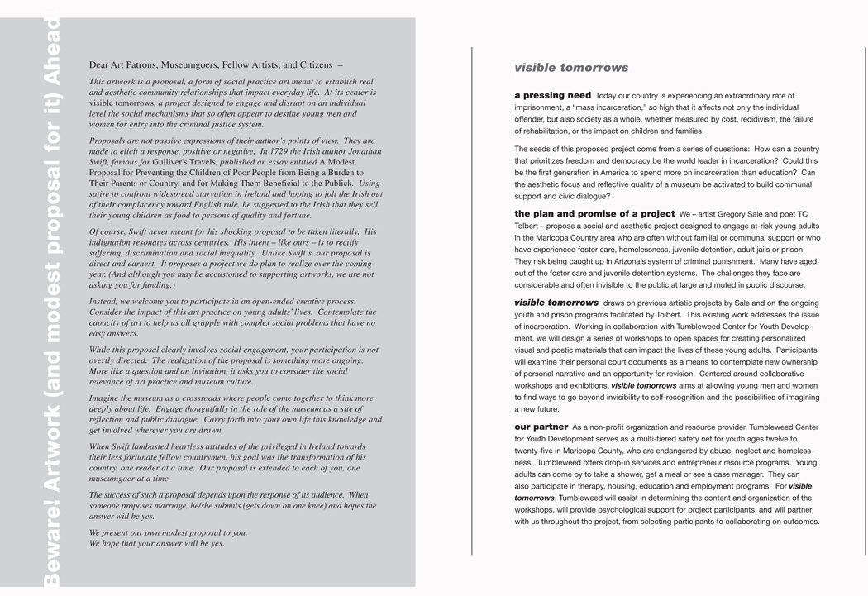

Slide 5
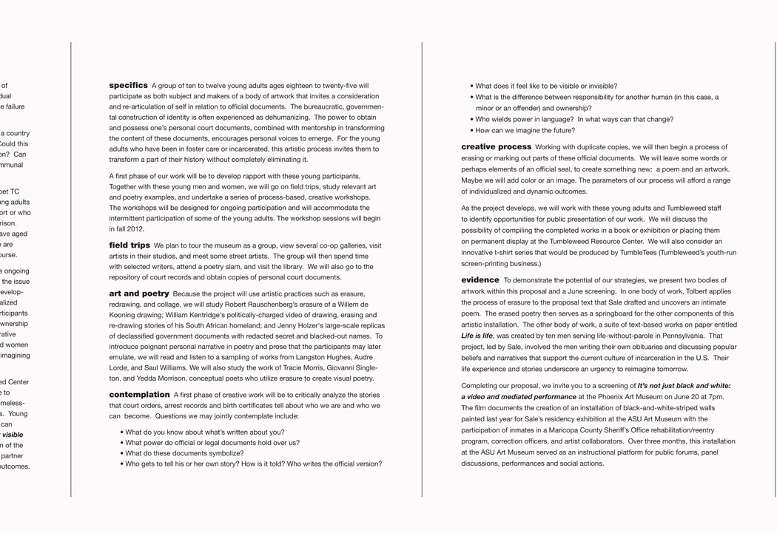

Slide 6
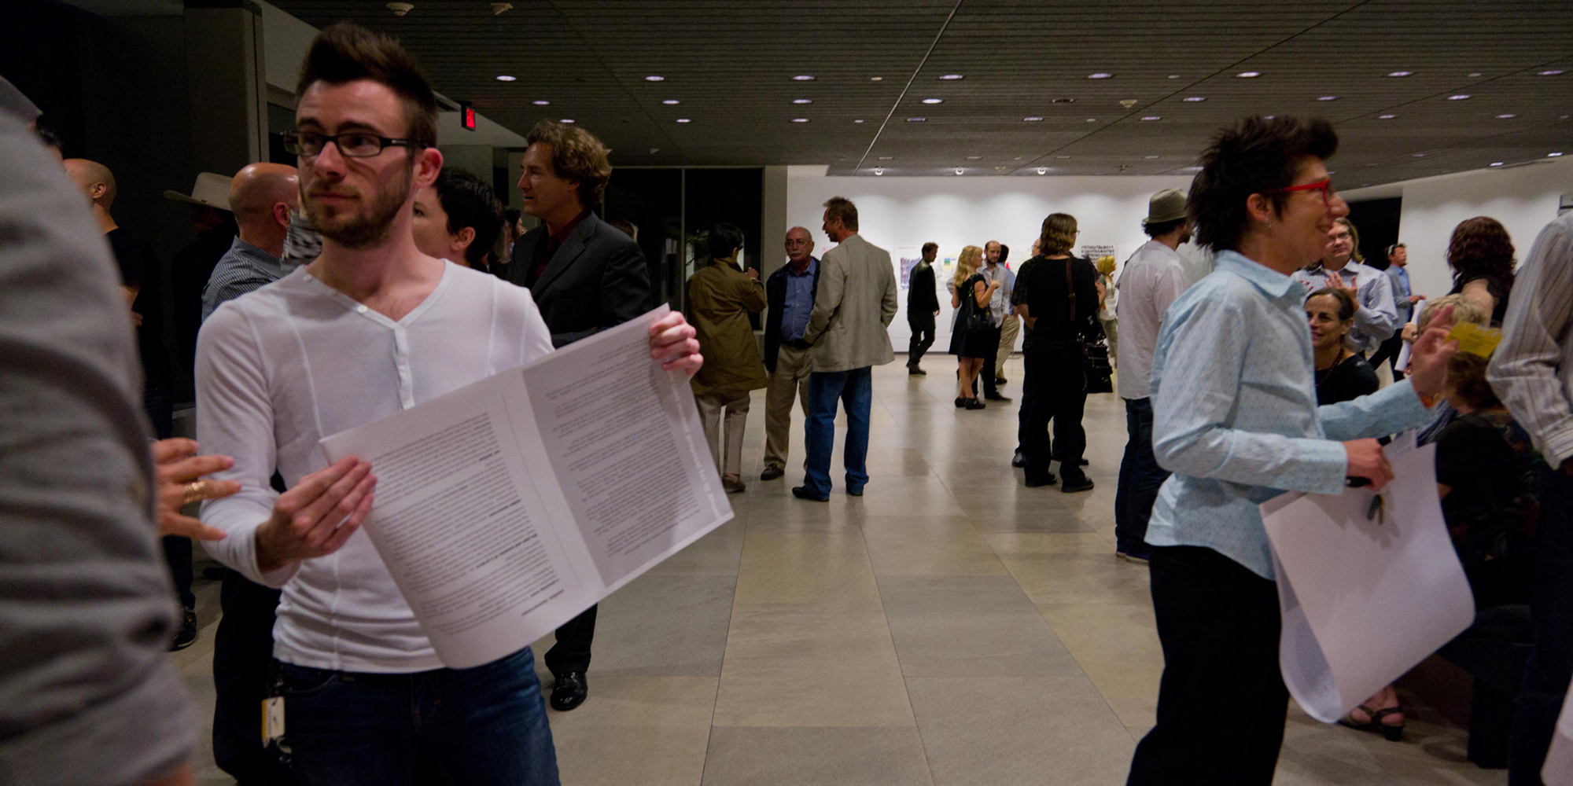
To demonstrate the potential of their strategies, Sale presented two bodies of artwork within this proposal and a June screening. In one body of work, project collaborator and poet, TC Tolbert applied the process of erasure to the proposal text that Sale drafted and uncovered an intimate poem.

Slide 7
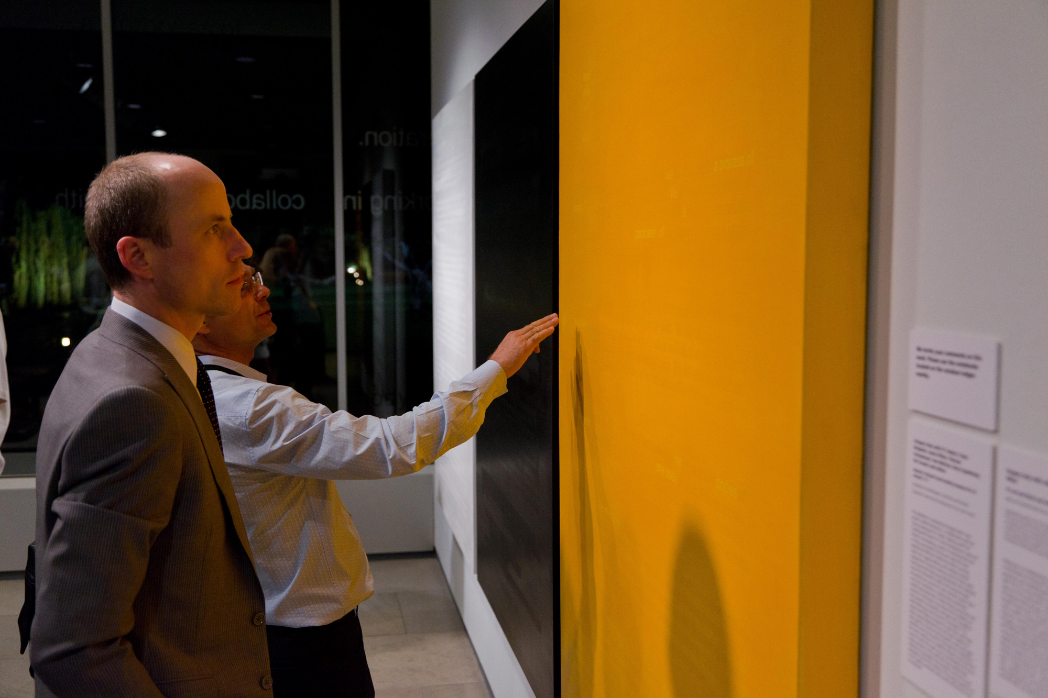

Slide 8
The proposal text and the new poem then served as a springboard for the other components of the artistic installation.

Slide 10
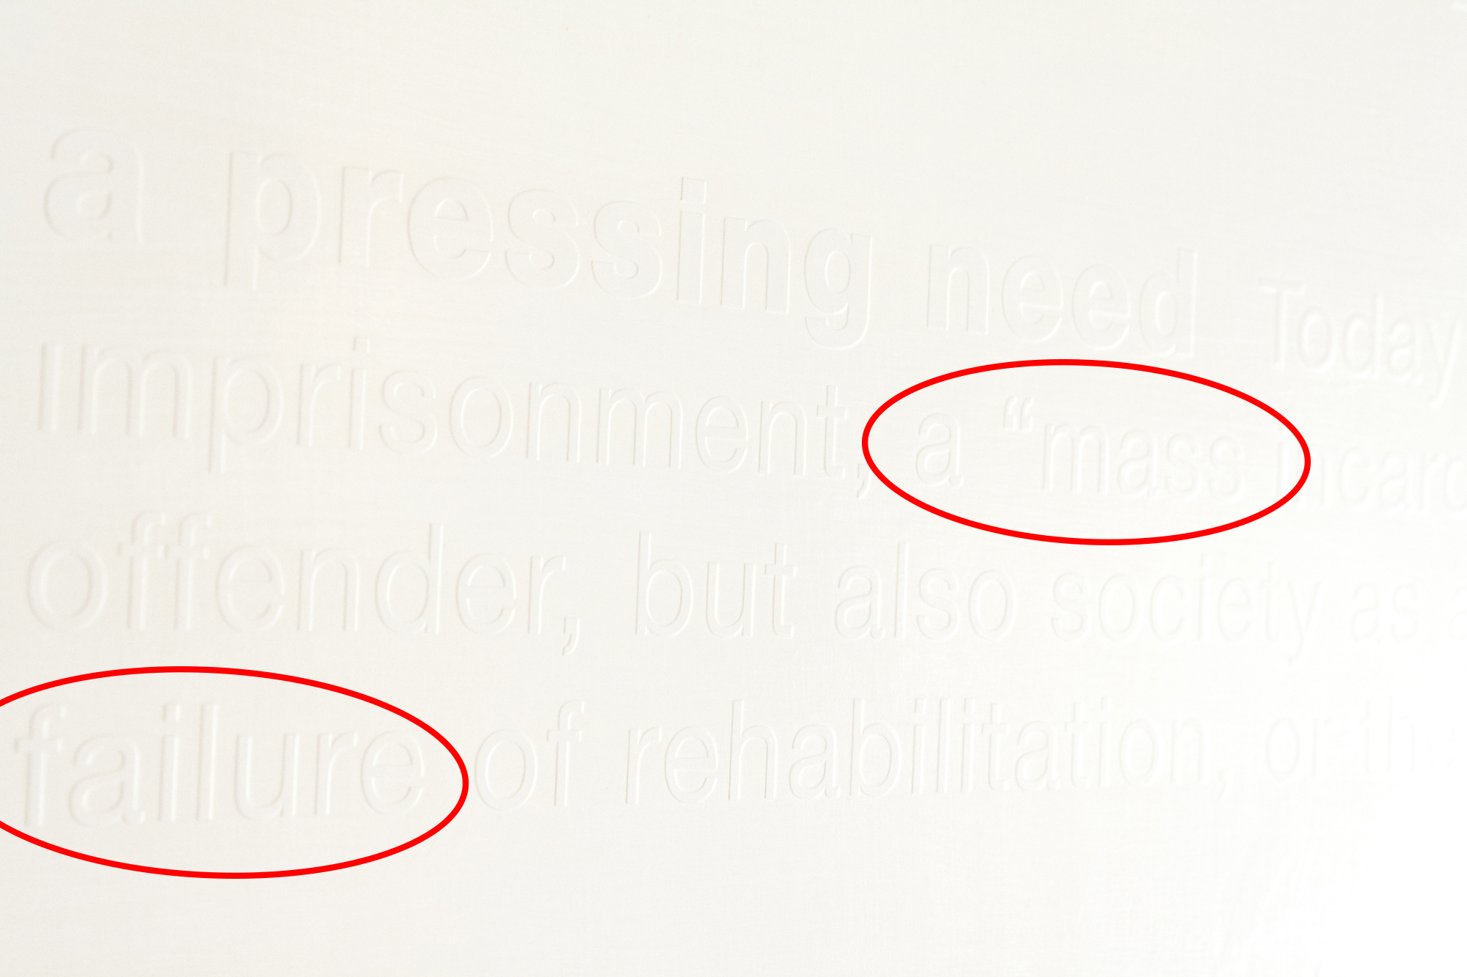

Slide 11
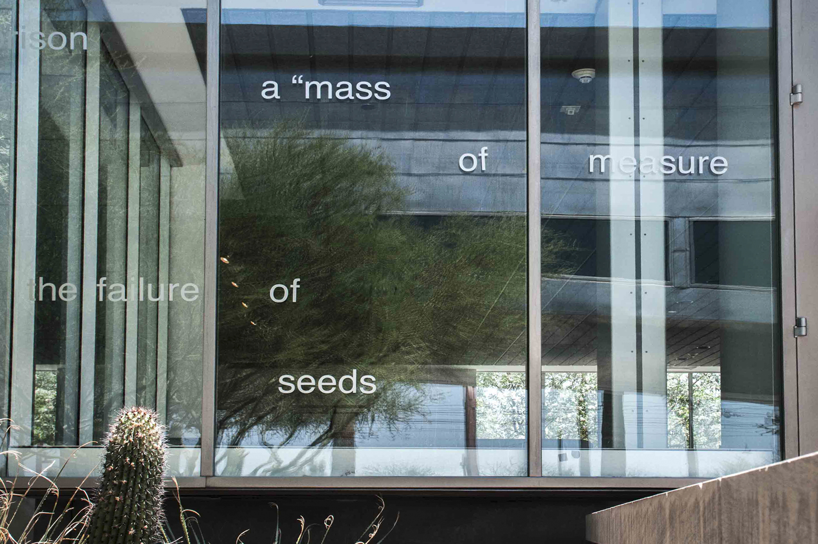

Slide 12
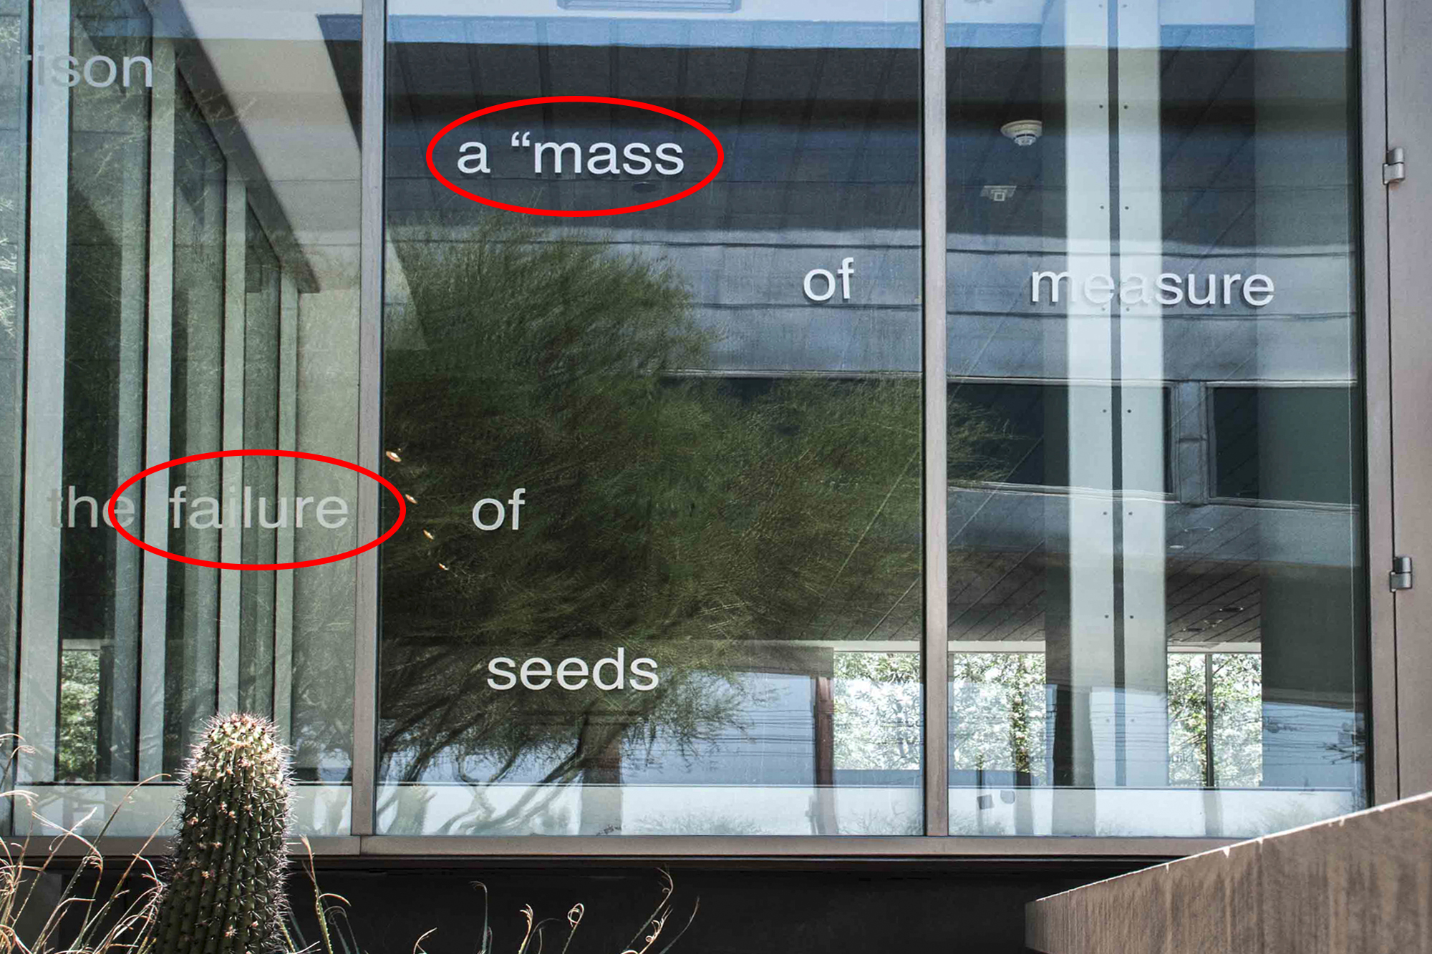

Slide 13
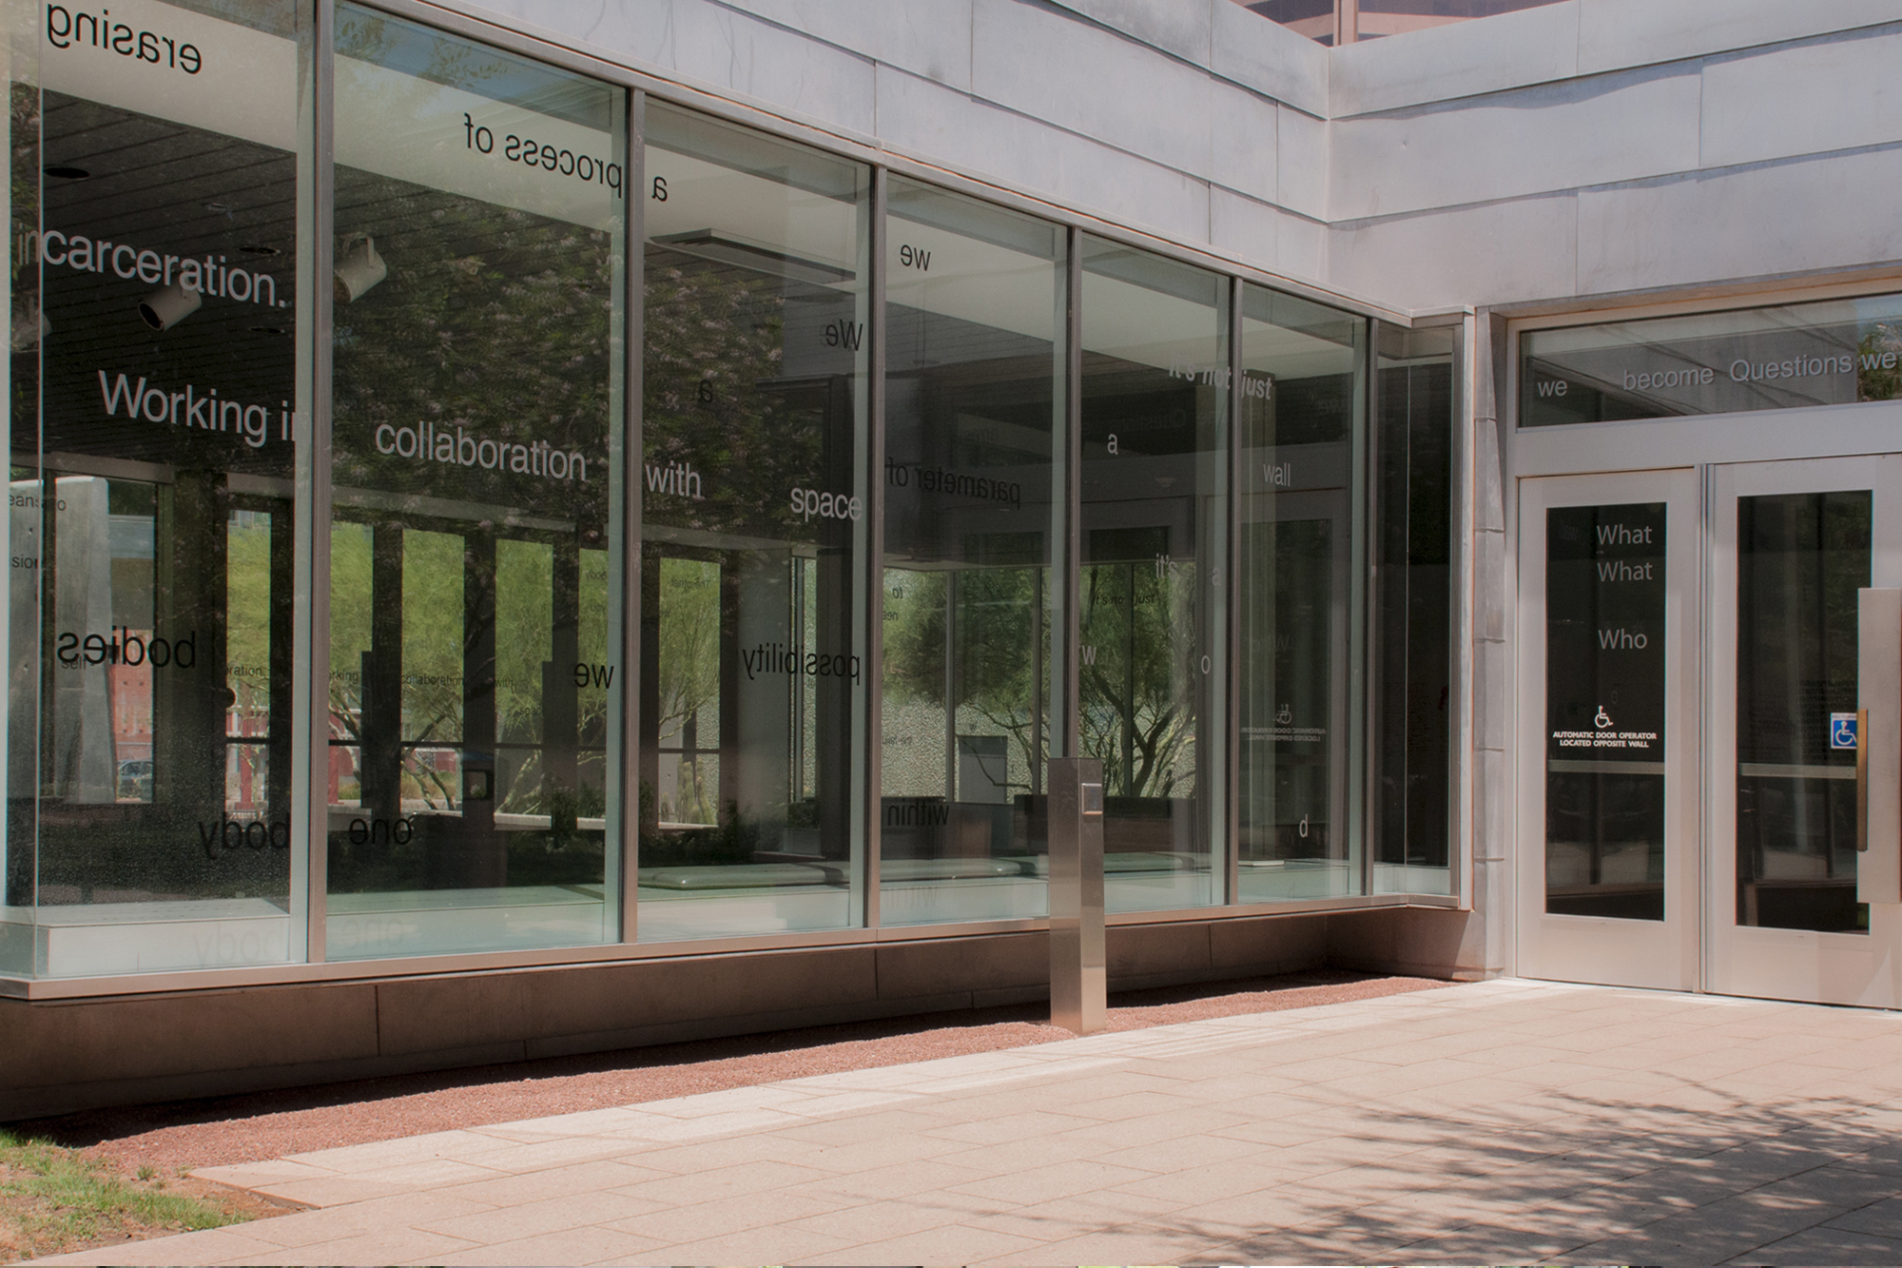

Slide 14
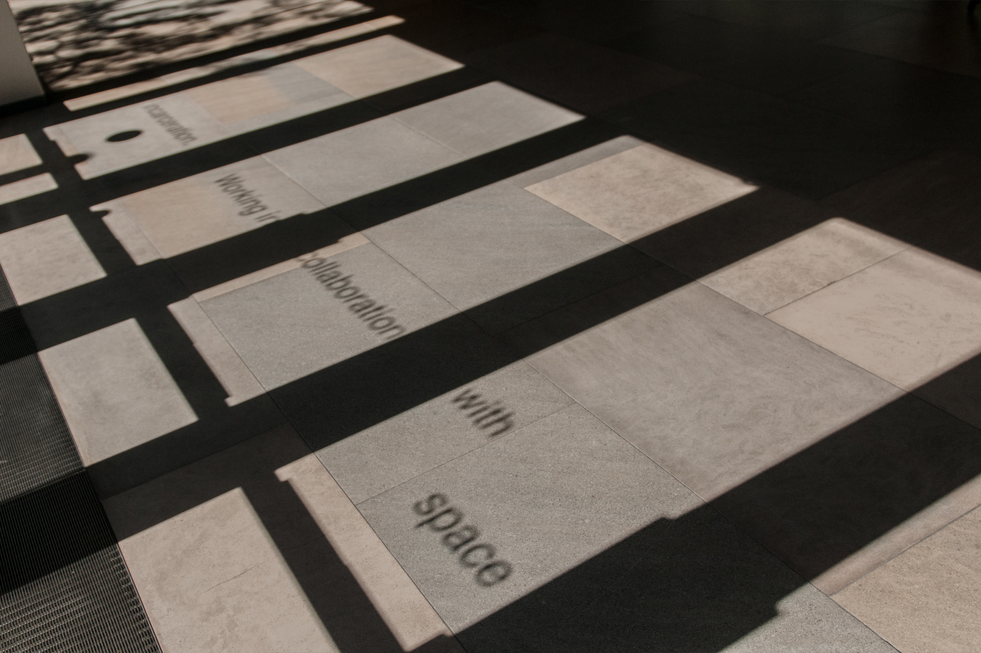

Slide 15
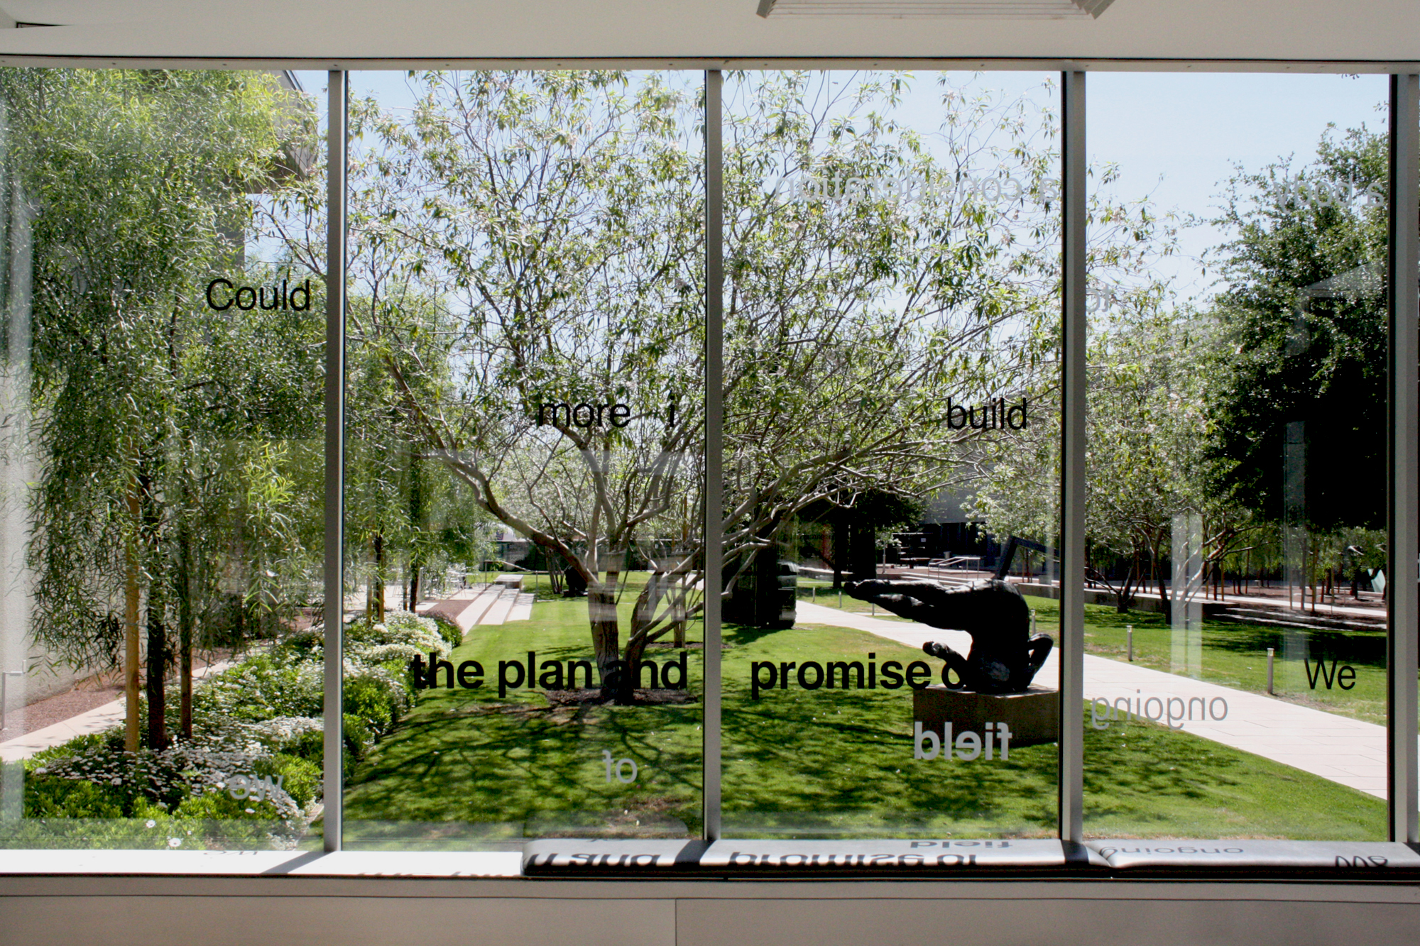

Slide 17
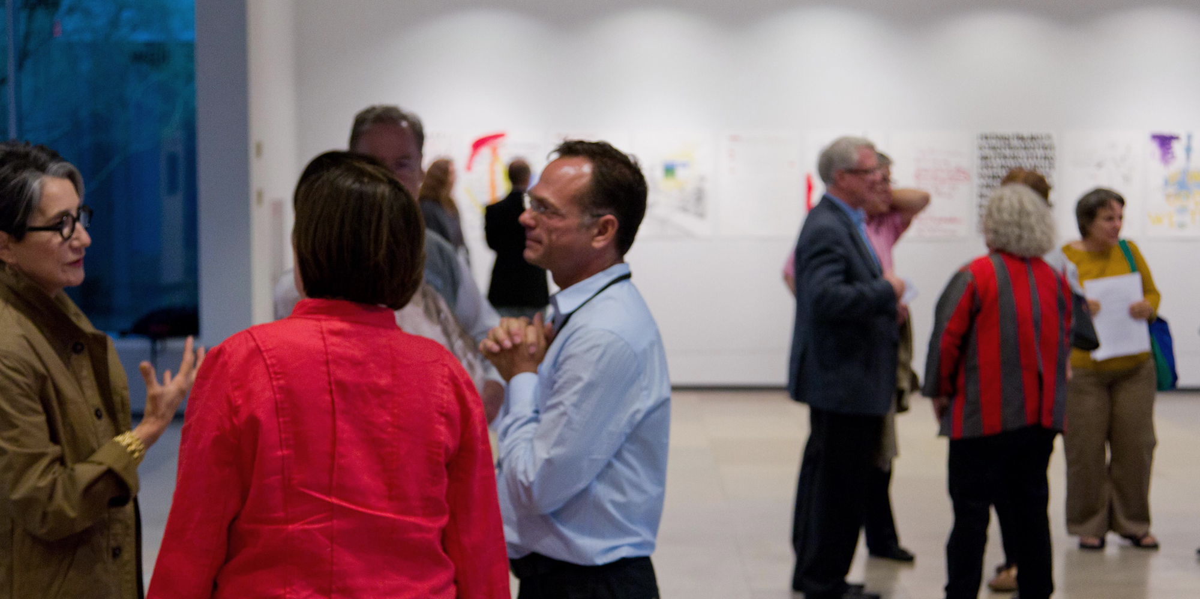
The other body of work, a suite of text-based works on paper entitled Life is Life, was created in collaboration with ten men serving life-without-parole in the State Correctional Institution at Graterford, PA.

Slide 18
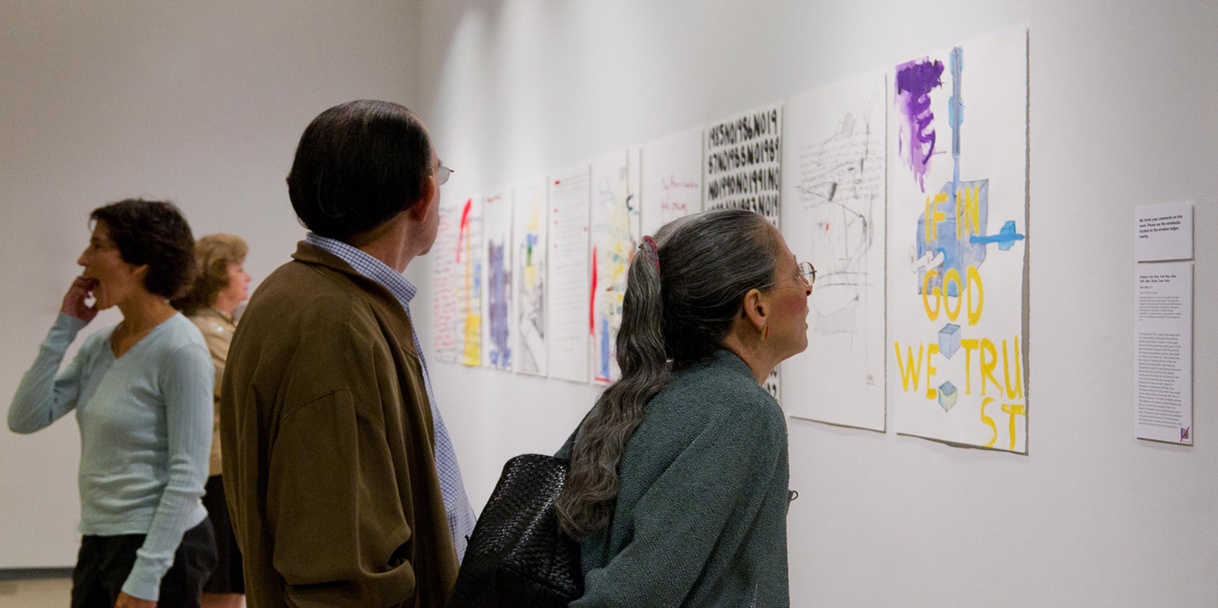
Sale led a series of artistic workshops that involved the men discussing popular beliefs and narratives that support the current culture of incarceration, considering personal life goals, and writing one’s own obituary. Their life experience and stories presented in the works underscore an urgency to reimagine tomorrow.

Slide 19
Completing the proposal, Sale hosted It’s not just black and white: a video and mediated performance. The digital film documents the creation of an installation at ASU Art Museum of striped walls painted with inmates in a Maricopa County Sheriff’s Office rehabilitation/reentry program, correction officers, and artist collaborators.

Slide 20
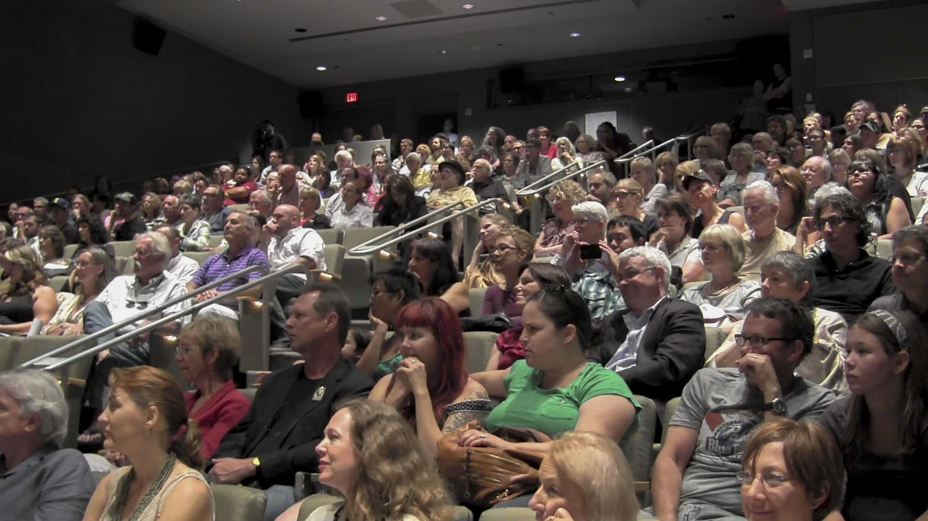
The auditorium at the Phoenix Art Museum was full to capacity on that evening.

Slide 21
During the screening, forty men and women from the re-entry community parti-cipated in the program as honored guests. As a performance, these individuals helped stage a series of interruptions to disrupt the movie-viewing experience.

Slide 22
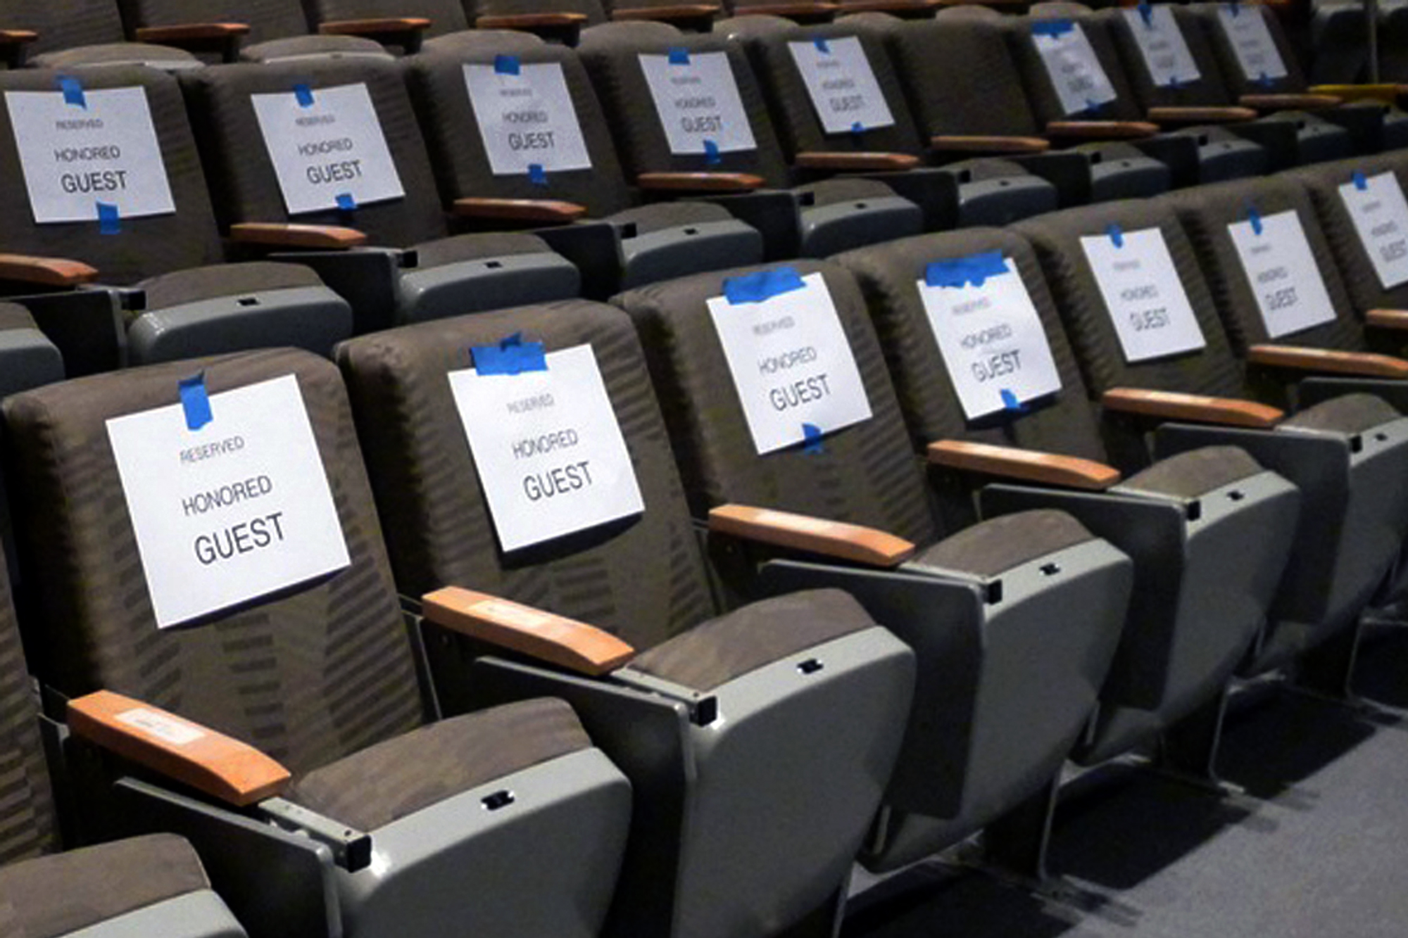

Slide 23
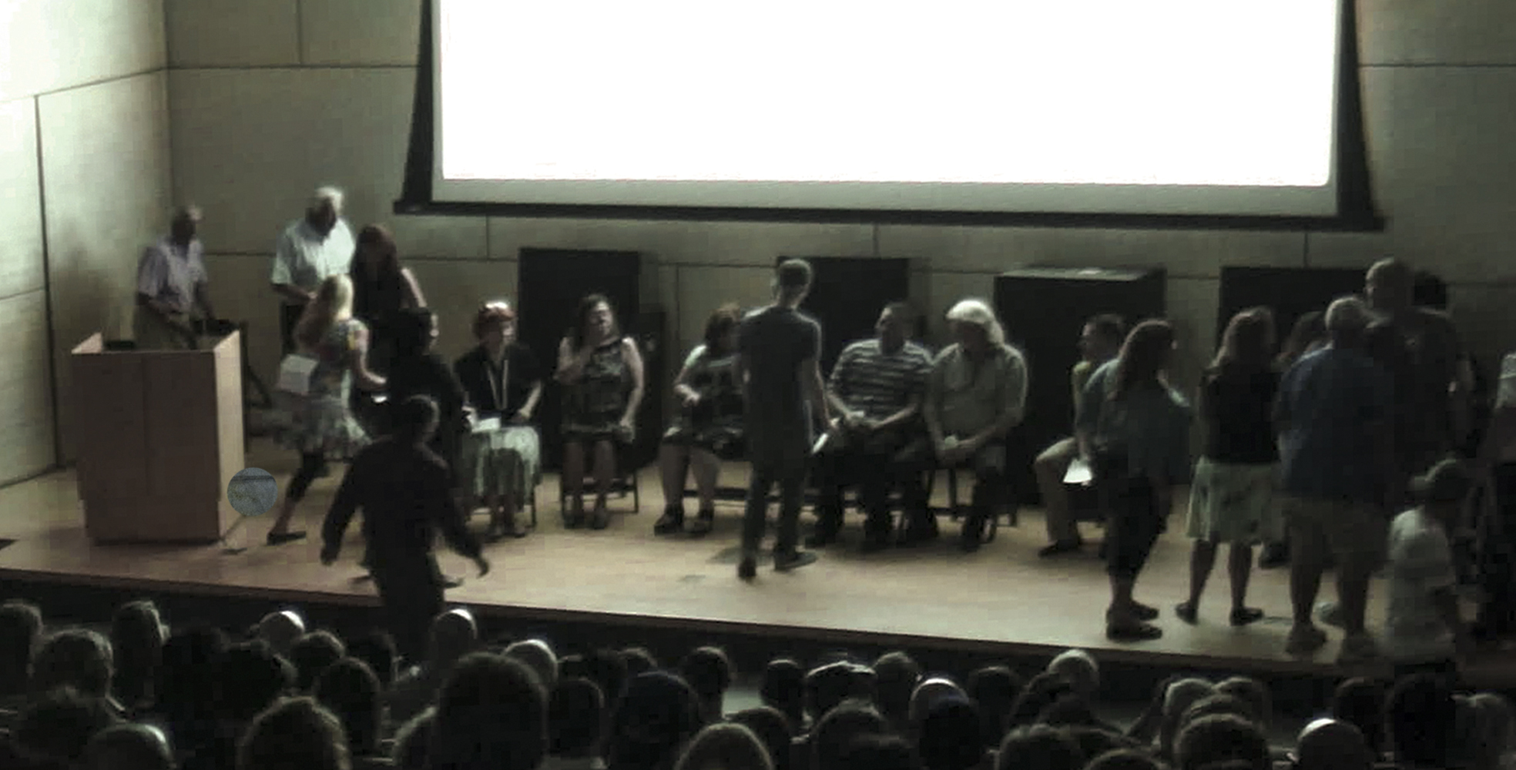
For the second half of the program, these honored guests moved to the stage and engaged in a dialogue with the other audience members.

Slide 24
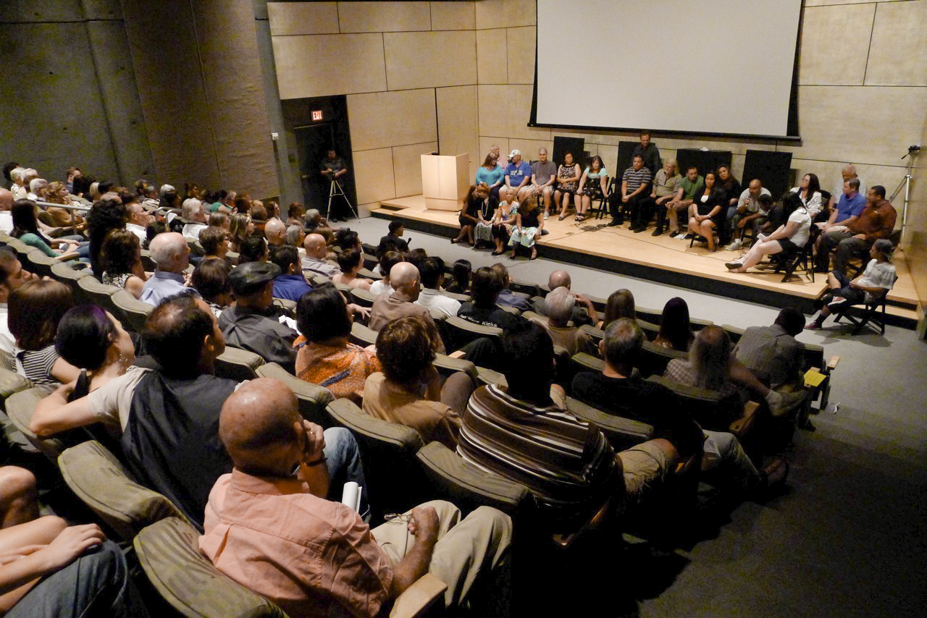

Slide 25
Beware! Artwork (and modest proposal for it) Ahead! was created in collaboration with TC Tolbert, Claes Bergman, Jason Dillon, Therese Grossmeyer, Ann Morton, Barry Sparkman, Eric Susser and Tumbleweed Center for Youth Development.
The series of text-based works on paper, Life is Life, was produced in collaboration with Van, Stan, Tom, Roy, John, Zafir, Spel, Chuck, Toan, and Felix and in conjunction with Mural Arts Restorative Justice Program in Philadelphia, the Pennsylvania State Correctional Institution at Graterford and supported in part by a grant from The Ford Foundation. With the support of Sara Cochran, Curator of Modern and Contemporary Art, Phoenix Art Museum. The project was made possible through the support of a Contemporary Forum Phoenix Art Museum Mid-Career Artist, Elaine and Sidney Cohen; and the Jane A. Lehman and Alan G. Lehman Foundation.
Gregory Sale, 2012

